Slide 1
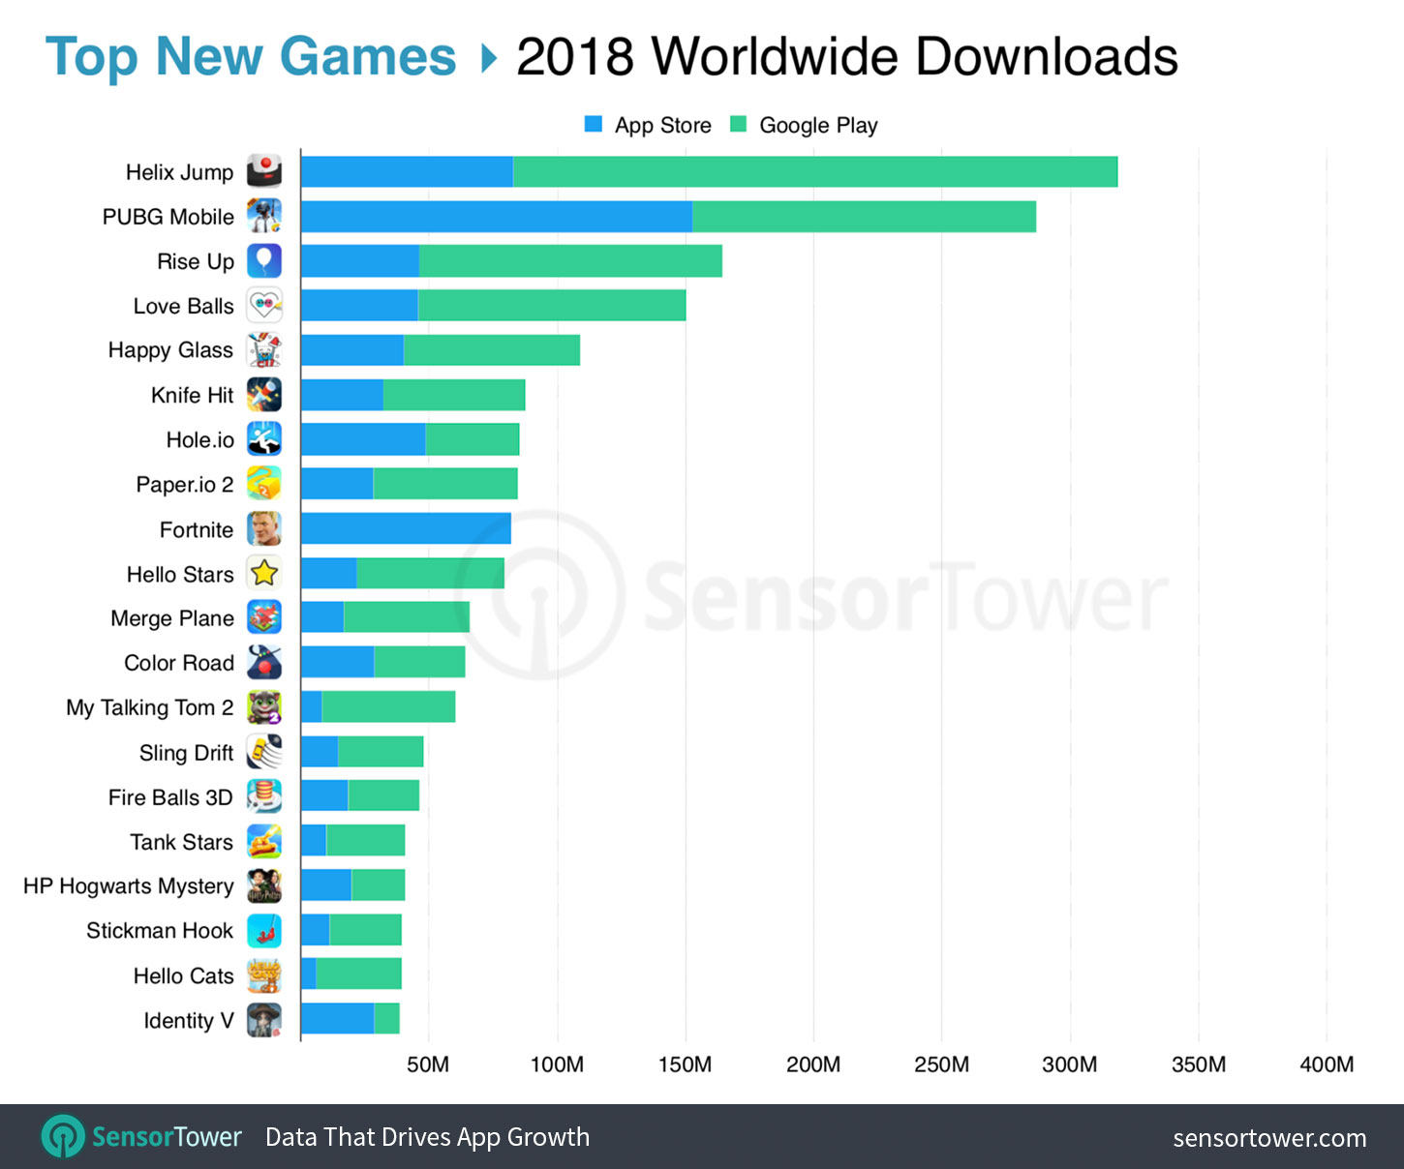
TOP GAMES OF 2018

Slide 2
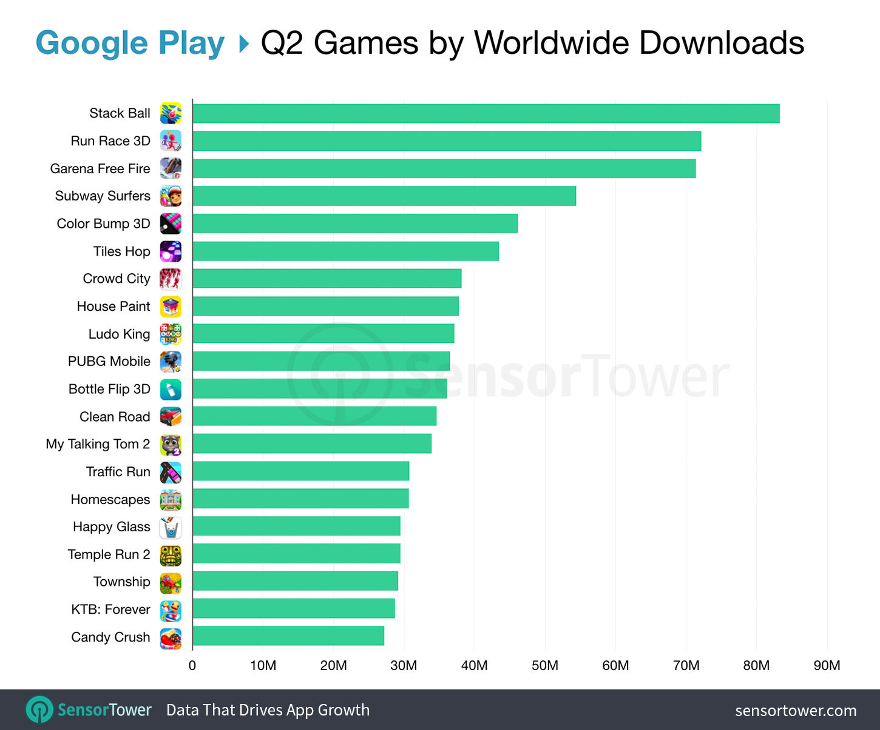
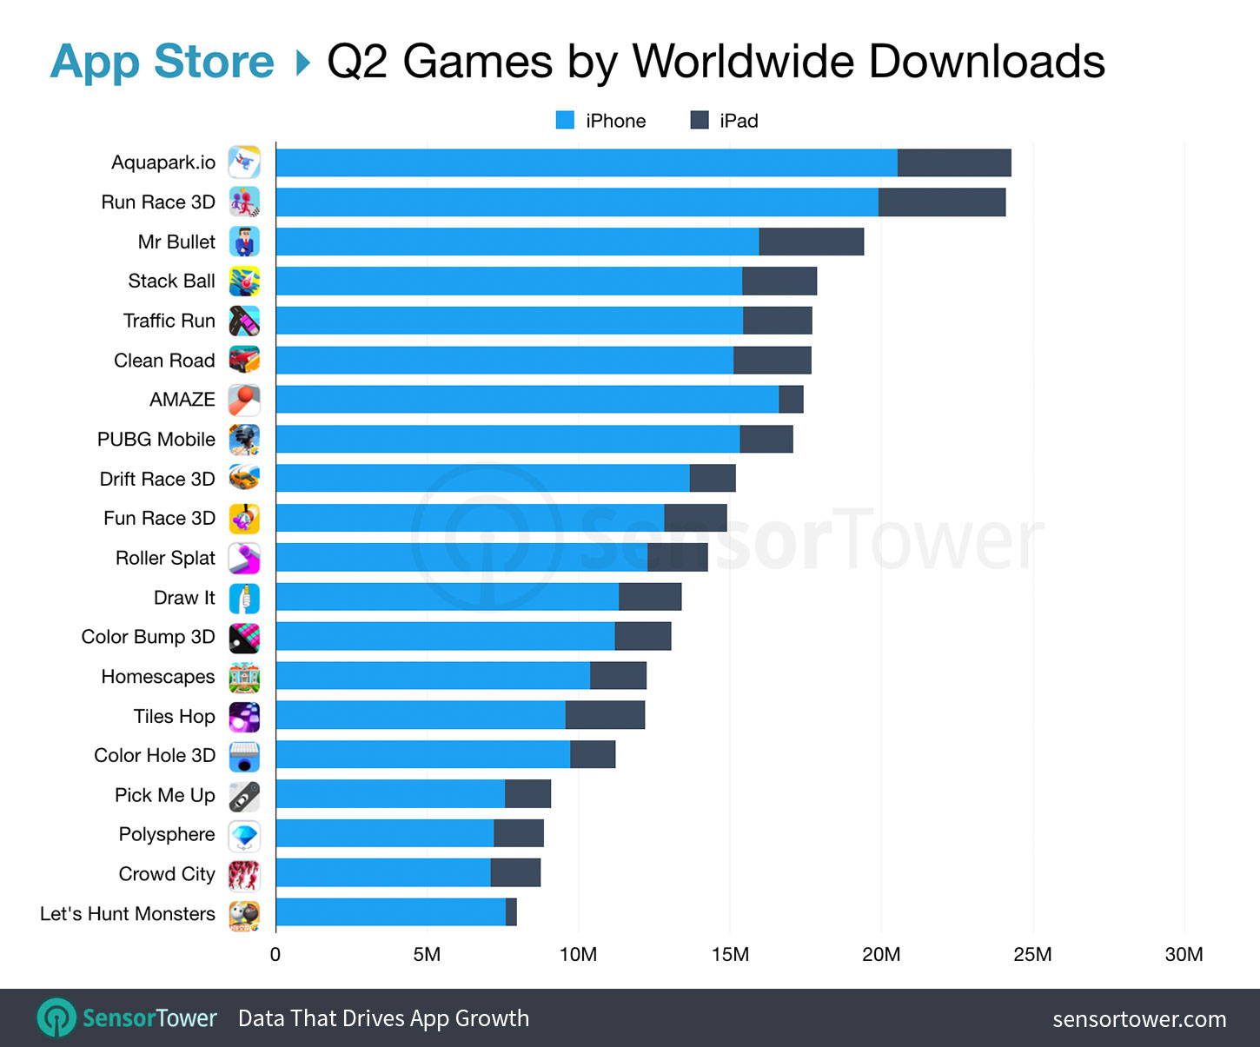
TOP GAMES OF 2018

Slide 3
TOP GAMES OF 2018

Slide 4
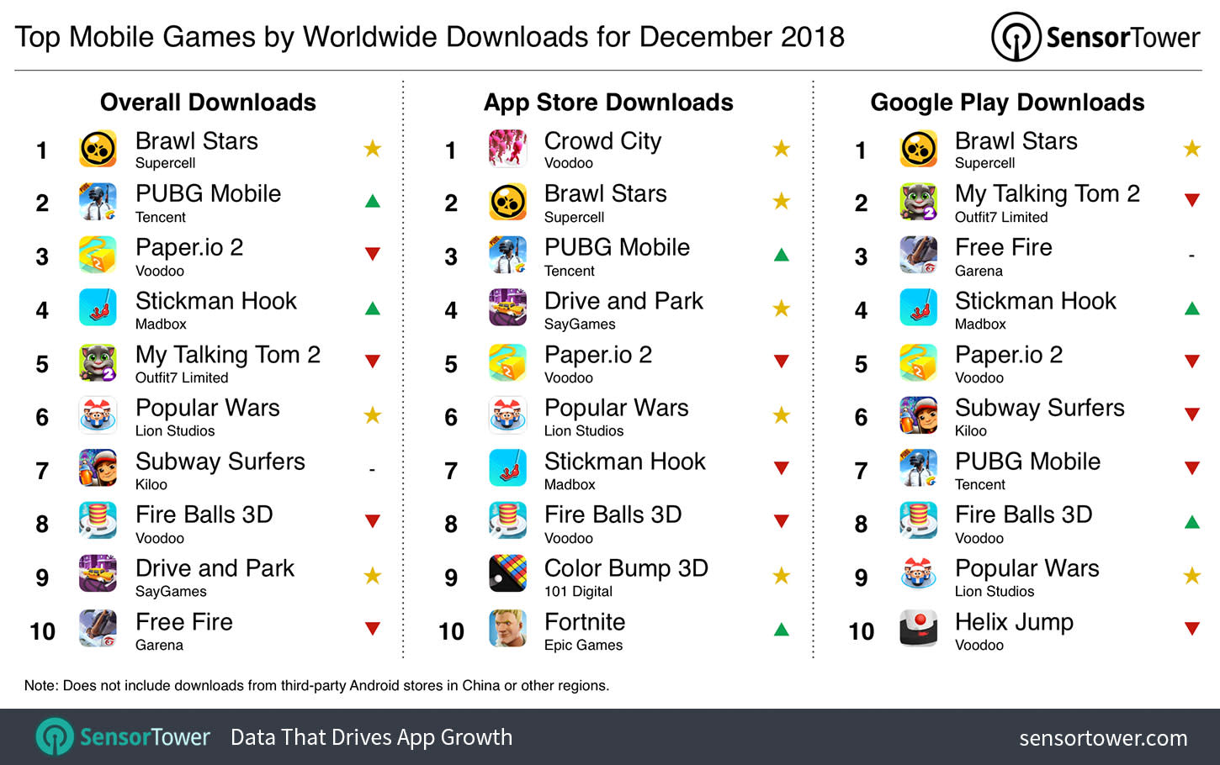
TOP GAMES OF 2018

